Slide 1
Kubernetes Practice
Dept. of smart finance
Korea Polytechnics
Wonyong Hwang, July 2023

Slide 2
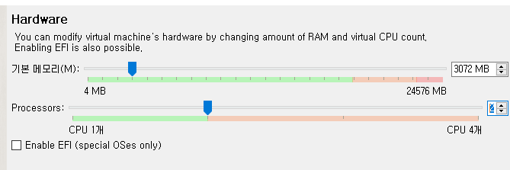
Requirements
We’ll make 2 VMs, one is master node and the other is worker node. Each node need to be set as below
CPU : 2 core (minimum)
RAM : 3GB (minimum)
Storage: 30GB(minimum)
OS : Ubuntu 22.04 (preferred)

Slide 3
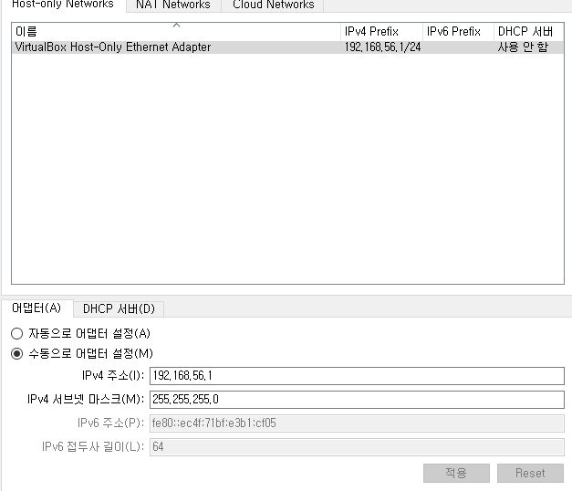
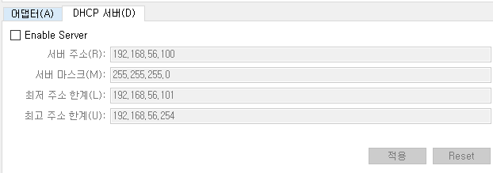
Network setup
In virtual box
1. Set a host network manager (menu -> file -> host network manager…)

Slide 4
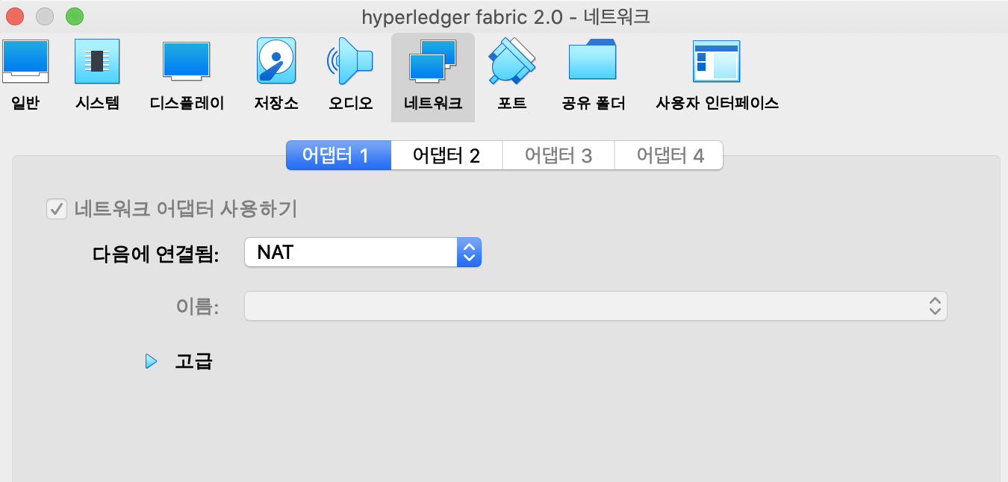
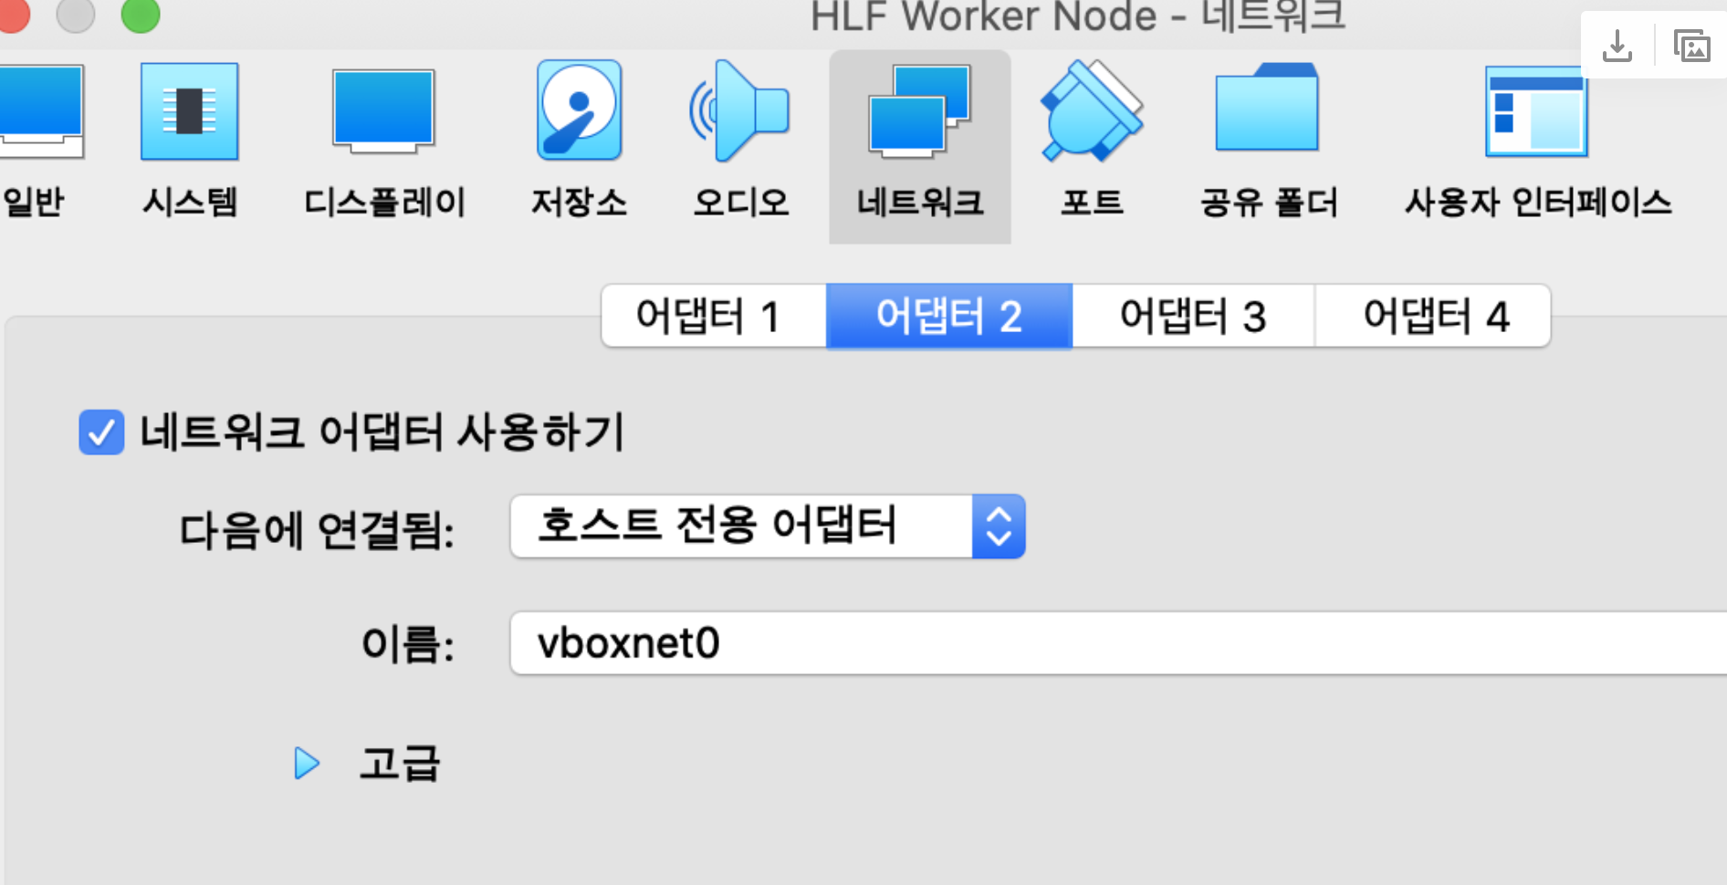
Network setup
In virtual box
Adaptor 1 : NAT
Adaptor 2: Host-Only Network

Slide 5
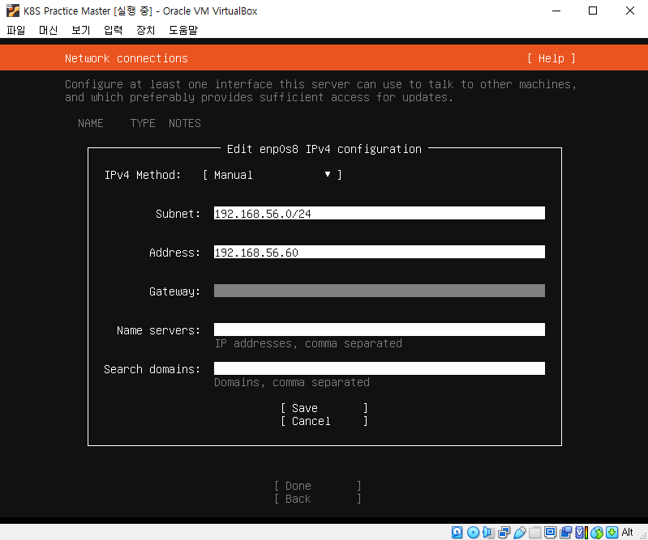
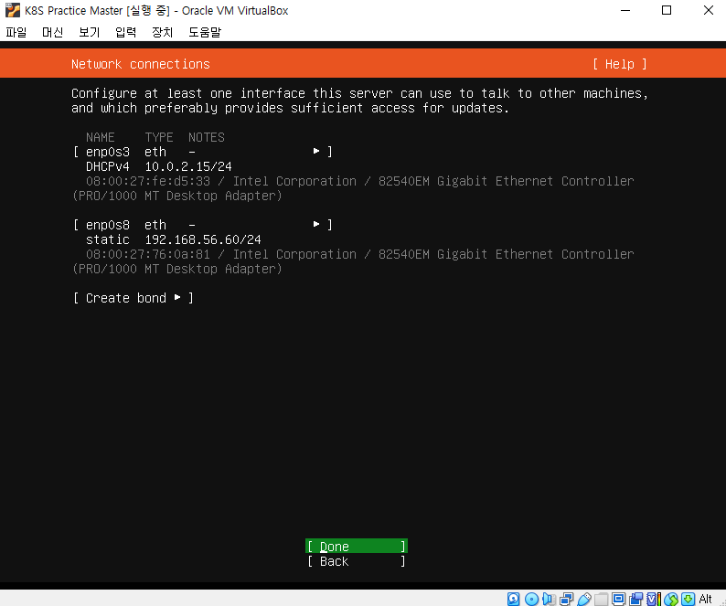
setup network info while installing

Slide 6
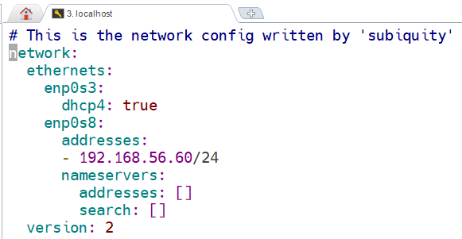
Network setup
check vi /etc/netplan/00-installer-config.yaml
Master
NAT
Host-Only Adapter
netplan apply
Reference : https://kubernetes.io/docs/concepts/extend-kubernetes/compute-storage-net/network-plugins/#network-plugin-requirements

Slide 7
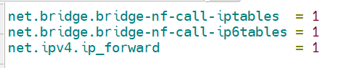
Network setup
vi /etc/sysctl.d/k8s.conf
sysctl --system
Notes:
bridge 네트워크를 통해 송수신되는 패킷이 iptables 설정을 우회한다는 의미
컨테이너의 네트워크 패킷이 호스트머신의 iptables 설정에 따라 제어되도록 하는 것이 바람직하며 이를 위해서는 이 값을 1로 설정해야 한다

Slide 8
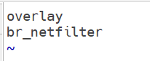
Network setup
cat <<EOF | sudo tee /etc/modules-load.d/k8s.conf
overlay
br_netfilter
EOF
modprobe overlay
modprobe br_netfilter

Slide 9
hostname
vi /etc/cloud/cloud.cfg
systemctl restart systemd-logind.service

Slide 10
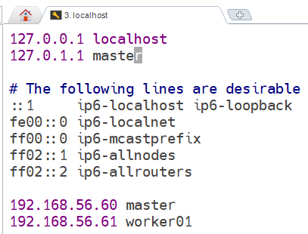
hosts
vi /etc/hosts
192.168.56.60 master
192.168.56.61 worker01

Slide 11
hostname setting
Hostname setting in worker node
If worker’s hostname is equal to master, then you will see following error message on worker node when executing kubeadm join >> a Node with name ** and and status "Ready" already exists in the cluster.
hostnamectl set-hostname worker01
vi /etc/cloud/cloud.cfg
Notes:
https://github.com/kubernetes/kubernetes/issues/89512
https://github.com/kubernetes/kubernetes/issues/79779

Slide 12
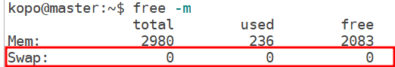
Requirements
Docker
Memory swap off swapoff -a
Check ports
vi /etc/fstab
https://kubernetes.io/docs/setup/production-environment/tools/kubeadm/install-kubeadm/

Slide 13
Requirements
Install Docker
apt-get -y install docker-compose
docker version
docker info
systemctl start docker
systemctl enable docker
docker-compose --version
Notes:
# docker -v
Docker version 20.10.21, build 20.10.21-0ubuntu1~22.04.3

Slide 14
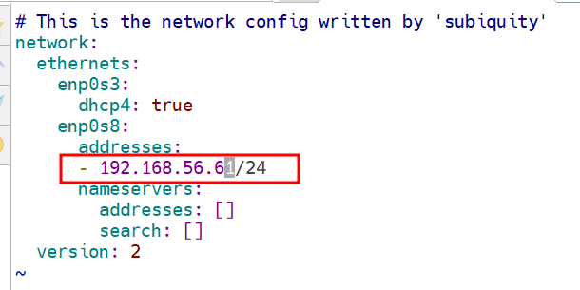
VM 복제
worker node
check vi /etc/netplan/00-installer-config.yaml
hostnamectl set-hostname worker01
netplan apply

Slide 15
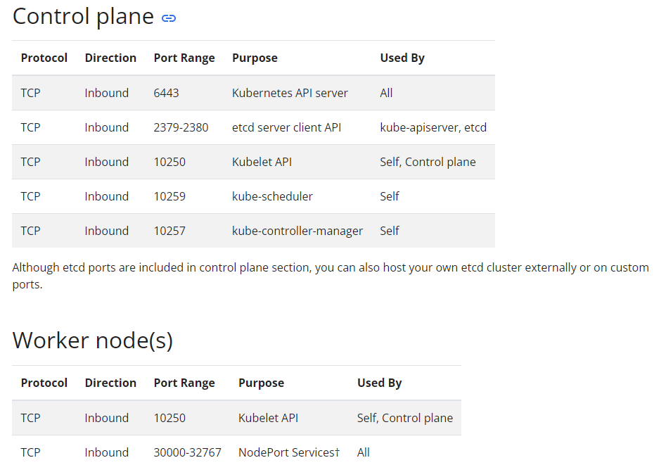
Port Open
master(control plane) node
ufw allow "OpenSSH"
ufw enable
ufw allow 6443/tcp
ufw allow 2379:2380/tcp
ufw allow 10250/tcp
ufw allow 10259/tcp
ufw allow 10257/tcp
ufw status
Worker node
https://kubernetes.io/docs/reference/networking/ports-and-protocols/
ufw allow "OpenSSH"
ufw enable
ufw status
ufw allow 10250/tcp
ufw allow 30000:32767/tcp
ufw status
[tip] virtual box range port forwarding
Vbox register(If needed) : VBoxManage registervm /Users/sf29/VirtualBox\ VMs/Worker/Worker.vbox
2. for i in {30000..30767}; do VBoxManage modifyvm "Worker" --natpf1 "tcp-port$i,tcp,,$i,,$i"; done

Slide 16
Kubernetes 설치

Slide 17
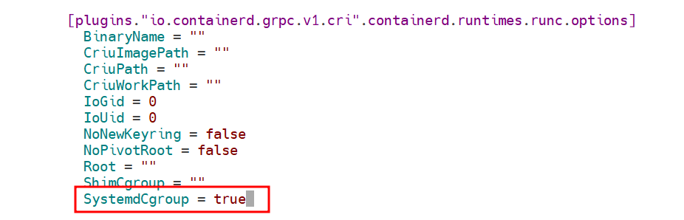
Kubernetes setup
Install containerd
curl -fsSL https://download.docker.com/linux/ubuntu/gpg | sudo gpg --dearmor -o /usr/share/keyrings/docker.gpg
echo "deb [arch=$(dpkg --print-architecture) signed-by=/usr/share/keyrings/docker.gpg] https://download.docker.com/linux/ubuntu \
$(lsb_release -cs) stable" | sudo tee /etc/apt/sources.list.d/docker.list > /dev/null
apt update
apt install containerd.io
systemctl stop containerd
mv /etc/containerd/config.toml /etc/containerd/config.toml.orig
containerd config default > /etc/containerd/config.toml
vi /etc/containerd/config.toml
SystemdCgroup = true
systemctl start containerd
systemctl is-enabled containerd
systemctl status containerd
Notes:
Cgroup : Control Group
다수의 Process가 포함되어 있는 Process Group 단위
Resource(cpu,mem,disk,nt) 사용량을 제한하고 격리시키는 Linux의 기능
Container의 Resource 제어에 사용

Slide 18
Kubernetes setup
Install kubernetes
apt install apt-transport-https ca-certificates curl -y
# curl -fsSLo /usr/share/keyrings/kubernetes-archive-keyring.gpg https://packages.cloud.google.com/apt/doc/apt-key.gpg
curl https://packages.cloud.google.com/apt/doc/apt-key.gpg | sudo apt-key --keyring /usr/share/keyrings/cloud.google.gpg add -
#echo "deb [signed-by=/usr/share/keyrings/kubernetes-archive-keyring.gpg] https://apt.kubernetes.io/ kubernetes-xenial main" | sudo tee /etc/apt/sources.list.d/kubernetes.list
echo "deb [signed-by=/usr/share/keyrings/cloud.google.gpg] https://apt.kubernetes.io/ kubernetes-xenial main" | sudo tee /etc/apt/sources.list.d/kubernetes.list
apt update
apt install kubelet kubeadm kubectl
apt-mark hold kubelet kubeadm kubectl
# 패키지가 자동으로 업그레이드 되지 않도록 고정
kubeadm version
kubelet --version
kubectl version
https://kubernetes.io/docs/setup/production-environment/tools/kubeadm/install-kubeadm/
Notes:
sudo apt-get update
sudo apt-get install -y apt-transport-https ca-certificates curl
curl -fsSL https://packages.cloud.google.com/apt/doc/apt-key.gpg | sudo gpg --dearmor -o /etc/apt/keyrings/kubernetes-archive-keyring.gpg
echo "deb [signed-by=/etc/apt/keyrings/kubernetes-archive-keyring.gpg] https://apt.kubernetes.io/ kubernetes-xenial main" | sudo tee /etc/apt/sources.list.d/kubernetes.list
sudo apt-get update
sudo apt-get install -y kubelet kubeadm kubectl
sudo apt-mark hold kubelet kubeadm kubectl

Slide 19
CNI(컨테이너 네트워크 인터페이스) 플러그인 설치
mkdir -p /opt/bin/
curl -fsSLo /opt/bin/flanneld https://github.com/flannel-io/flannel/releases/download/v0.19.0/flanneld-amd64
chmod +x /opt/bin/flanneld
lsmod | grep br_netfilter
kubeadm config images pull

Slide 20

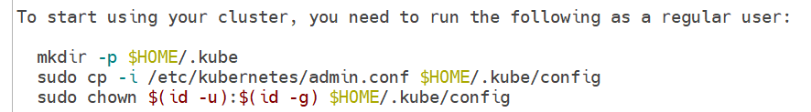
Master node setting
Kubeadm init
kubeadm init --pod-network-cidr=10.244.0.0/16 \
--apiserver-advertise-address=192.168.56.60 \
--cri-socket=unix:///run/containerd/containerd.sock
Your ip address
Reference : https://kubernetes.io/docs/setup/production-environment/tools/kubeadm/create-cluster-kubeadm/
Notes:
kubeadm init’ prechecks several things and installs the cluster control plane components. This may take several minutes. As a result of ‘kubeadm init’, at the end of a output contains 2 rows of information like this;
Then, you can copy those lines and paste on worker terminal to run (above token expires 24hrs later)

Slide 21
Master node setting
mkdir -p $HOME/.kube
cp -i /etc/kubernetes/admin.conf $HOME/.kube/config
chown $(id -u):$(id -g) $HOME/.kube/config
kubectl cluster-info
kubectl apply -f https://raw.githubusercontent.com/flannel-io/flannel/master/Documentation/kube-flannel.yml
kubectl get pods --all-namespaces
Reference : https://kubernetes.io/docs/setup/production-environment/tools/kubeadm/create-cluster-kubeadm/
Notes:
root@master:~/.kube# kubectl cluster-info
Kubernetes control plane is running at https://192.168.56.60:6443
CoreDNS is running at https://192.168.56.60:6443/api/v1/namespaces/kube-system/services/kube-dns:dns/proxy
To further debug and diagnose cluster problems, use 'kubectl cluster-info dump'.
root@master:~/.kube# kubectl apply -f https://raw.githubusercontent.com/flannel-io/flannel/master/Documentation/kube-flannel.yml
namespace/kube-flannel created
clusterrole.rbac.authorization.k8s.io/flannel created
clusterrolebinding.rbac.authorization.k8s.io/flannel created
serviceaccount/flannel created
configmap/kube-flannel-cfg created
daemonset.apps/kube-flannel-ds created

Slide 22
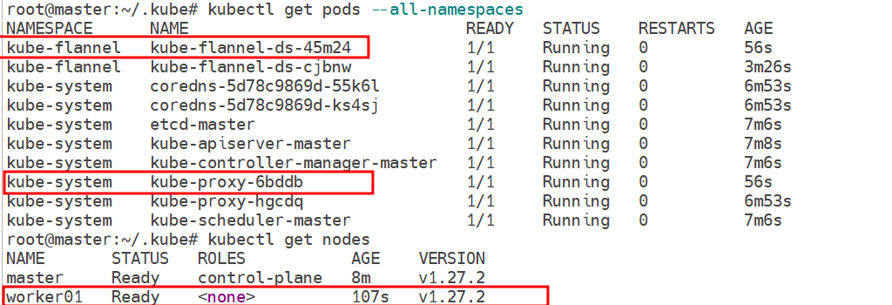
Worker Node Join
kubeadm join 192.168.56.60:6443 --token arh6up.usqi6daj82rj4rg2 \
--discovery-token-ca-cert-hash sha256:12035aced64146fc7ccc5e3e737192c7209bc6bacc3fdb5b14400f6f9fd9adfa
master node:
kubectl get pods --all-namespaces
kubectl get nodes -o wide
curl -k https://localhost:6443/version
Notes:
kubeadm join 192.168.56.60:6443 --token arh6up.usqi6daj82rj4rg2 \
--discovery-token-ca-cert-hash sha256:12035aced64146fc7ccc5e3e737192c7209bc6bacc3fdb5b14400f6f9fd9adfa
[preflight] Running pre-flight checks
[preflight] Reading configuration from the cluster...
[preflight] FYI: You can look at this config file with 'kubectl -n kube-system get cm kubeadm-config -o yaml'
[kubelet-start] Writing kubelet configuration to file "/var/lib/kubelet/config.yaml"
[kubelet-start] Writing kubelet environment file with flags to file "/var/lib/kubelet/kubeadm-flags.env"
[kubelet-start] Starting the kubelet
[kubelet-start] Waiting for the kubelet to perform the TLS Bootstrap...
This node has joined the cluster:
* Certificate signing request was sent to apiserver and a response was received.
* The Kubelet was informed of the new secure connection details.
Run 'kubectl get nodes' on the control-plane to see this node join the cluster.

Slide 23
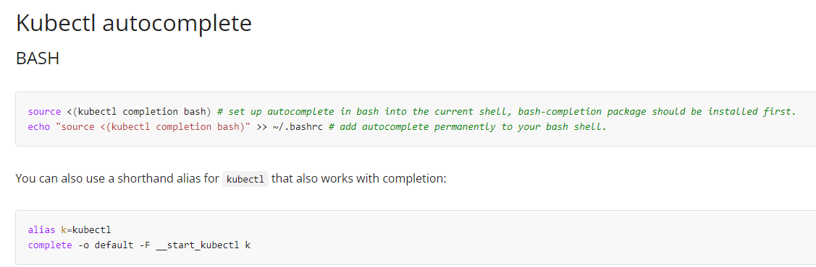
Kubectl Autocomplete
K = kubectl
source <(kubectl completion bash) # set up autocomplete in bash into the current shell, bash-completion package should be installed first.
echo "source <(kubectl completion bash)" >> ~/.bashrc # add autocomplete permanently to your bash shell.
vi ~/.bashrc 에 제일 아래, 다음 명령 추가
alias k=kubectl
complete -o default -F __start_kubectl k
추가 후, 바로 적용
source ~/.bashrc
Source : https://kubernetes.io/docs/reference/kubectl/cheatsheet/

Slide 24
Hello world

Slide 25
hello world
Master node : deploy pod
Worker node : check the pod is running
root@kopo:~# kubectl create deployment kubernetes-bootcamp --image=gcr.io/google-samples/kubernetes-bootcamp:v1
deployment.apps/kubernetes-bootcamp created
root@kopo:~# k get deployments.apps
NAME READY UP-TO-DATE AVAILABLE AGE
kubernetes-bootcamp 0/1 1 0 12s
root@kopo:~# k get deployments.apps
NAME READY UP-TO-DATE AVAILABLE AGE
kubernetes-bootcamp 1/1 1 1 19s
root@kopo:~# k get pods -o wide
NAME READY STATUS RESTARTS AGE IP NODE NOMINATED NODE READINESS GATES
kubernetes-bootcamp-6f6656d949-sdhqp 1/1 Running 0 35s 10.244.1.2 worker01 <none> <none>
root@worker01:~# curl http://10.244.1.2:8080
Hello Kubernetes bootcamp! | Running on: kubernetes-bootcamp-6f6656d949-sdhqp | v=1
Notes:
K delete deployment ku~

Slide 26
Terminology and concept

Slide 27
get
kubectl get all
kubectl get nodes
kubectl get nodes -o wide
kubectl get nodes -o yaml
kubectl get nodes -o json
describe
kubectl describe node <node name>
kubectl describe node/<node name>
Other
kubectl exec -it <POD_NAME>
kubectl logs -f <POD_NAME|TYPE/NAME>
kubectl apply -f <FILENAME>
kubectl delete -f <FILENAME>

Slide 28
Deployment method
Daemon set : only single container per each node
Replica set : control a number of container
Stateful set : replica set + control sequence
Worker Node #1
Worker Node #1
Worker Node #1
<Pod>
Daemon
<Pod>
Daemon
<Pod>
Daemon
Daemon Set

Slide 29
Kubectl practice

Slide 30

Make a pod
One container / one pod
k apply -f first-deploy.yml
k get po k get all k describe po/kopotest
apiVersion: v1
kind: Pod
metadata:
name: kopotest
labels:
type: app
spec:
containers:
- name: app
image: nginx:latest
Must be lower case
Liveness probe : check after boot up
Readiness probe : check before boot up
apiVersion: v1
kind: Pod
metadata:
name: kopotest-lp
labels:
type: app
spec:
containers:
- name: app
image: nginx:latest
livenessProbe:
httpGet:
path: /not/exist
port: 80
initialDelaySeconds: 5
timeoutSeconds: 2 # Default 1
periodSeconds: 5 # Defaults 10
failureThreshold: 1 # Defaults 3
<Liveness Probe Example> k describe po/kopotest-lp : Liveness probe failed: HTTP probe failed with statuscode: 404
k get po
k delete pod kopotest-lp

Slide 31
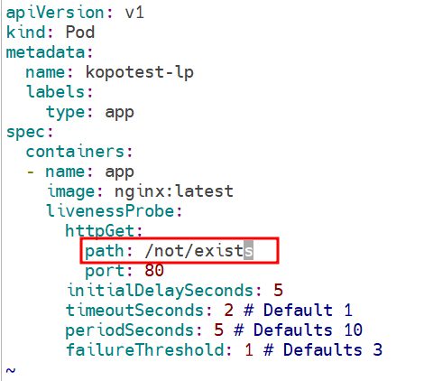
Make a pod
One container / one pod

Slide 32
Make a pod
One container / one pod
Healthcheck k apply -f *.yml
root@kopo:~/project/ex01# k describe po/wkopo-healthcheck
Name: wkopo-healthcheck
Namespace: default
Priority: 0
Node: worker01/10.0.2.15
Start Time: Thu, 23 Jul 2020 11:40:37 +0000
Labels: type=app
Annotations: Status: Running
IP: 10.244.1.6
IPs:
IP: 10.244.1.6
Containers:
app:
Container ID: docker://064d9b4841dd4712c63669e770cfaf0ad5ba39ee9ca2d9ac4ed44b12224efc5b
Image: nginx:latest
Image ID: docker-pullable://nginx@sha256:0e188877aa60537d1a1c6484b8c3929cfe09988145327ee47e8e91ddf6f76f5c
Port: <none>
Host Port: <none>
State: Running
Started: Thu, 23 Jul 2020 11:40:42 +0000
Ready: True
Restart Count: 0
Liveness: http-get http://:80/ delay=0s timeout=1s period=10s #success=1 #failure=3
Readiness: http-get http://:80/ delay=0s timeout=1s period=10s #success=1 #failure=3
Environment: <none>
Mounts:
/var/run/secrets/kubernetes.io/serviceaccount from default-token-h56q7 (ro)
Conditions:
Type Status
Initialized True
Ready True
ContainersReady True
PodScheduled True
Volumes:
default-token-h56q7:
Type: Secret (a volume populated by a Secret)
SecretName: default-token-h56q7
Optional: false
QoS Class: BestEffort
Node-Selectors: <none>
Tolerations: node.kubernetes.io/not-ready:NoExecute for 300s
node.kubernetes.io/unreachable:NoExecute for 300s
Events:
Type Reason Age From Message
---- ------ ---- ---- -------
Normal Scheduled 35s default-scheduler Successfully assigned default/wkopo-healthcheck to worker01
Normal Pulling 34s kubelet, worker01 Pulling image "nginx:latest"
Normal Pulled 30s kubelet, worker01 Successfully pulled image "nginx:latest"
Normal Created 30s kubelet, worker01 Created container app
Normal Started 30s kubelet, worker01 Started container app
root@kopo:~/project/ex01# k get po
NAME READY STATUS RESTARTS AGE
kopotest 1/1 Running 0 28m
kubernetes-bootcamp-6f6656d949-sdhqp 1/1 Running 0 8h
wkopo-healthcheck 1/1 Running 0 43s
apiVersion: v1
kind: Pod
metadata:
name: wkopo-healthcheck
labels:
type: app
spec:
containers:
- name: app
image: nginx:latest
livenessProbe:
httpGet:
path: /
port: 80
readinessProbe:
httpGet:
path: /
port: 80
참조 : https://bcho.tistory.com/1264
Notes:
kubectl delete -f ./

Slide 33
Make a pod
Multi container / one pod
apiVersion: v1
kind: Pod
metadata:
name: two-containers
spec:
restartPolicy: Never
volumes:
- name: shared-data
emptyDir: {}
containers:
- name: nginx-container
image: nginx
volumeMounts:
- name: shared-data
mountPath: /usr/share/nginx/html
- name: debian-container
image: debian
volumeMounts:
- name: shared-data
mountPath: /pod-data
command: ["/bin/sh"]
args: ["-c", "echo debian 컨테이너에서 안녕하세요 > /pod-data/index.html"]
K apply -f multi-container.yml
root@kopo:~/project/ex02# k get pod
NAME READY STATUS RESTARTS AGE
kubernetes-bootcamp-6f6656d949-sdhqp 1/1 Running 0 10h
two-containers 1/2 NotReady 0 34m
root@kopo:~/project/ex02# k logs po/two-containers
error: a container name must be specified for pod two-containers, choose one of: [nginx-container debian-container]
root@kopo:~/project/ex02# k logs po/two-containers nginx-container
/docker-entrypoint.sh: /docker-entrypoint.d/ is not empty, will attempt to perform configuration
/docker-entrypoint.sh: Looking for shell scripts in /docker-entrypoint.d/
/docker-entrypoint.sh: Launching /docker-entrypoint.d/10-listen-on-ipv6-by-default.sh
10-listen-on-ipv6-by-default.sh: Getting the checksum of /etc/nginx/conf.d/default.conf
10-listen-on-ipv6-by-default.sh: Enabled listen on IPv6 in /etc/nginx/conf.d/default.conf
/docker-entrypoint.sh: Launching /docker-entrypoint.d/20-envsubst-on-templates.sh
/docker-entrypoint.sh: Configuration complete; ready for start up
127.0.0.1 - - [23/Jul/2020:12:52:56 +0000] "GET / HTTP/1.1" 200 42 "-" "curl/7.64.0" "-"
Source : https://kubernetes.io/docs/tasks/access-application-cluster/communicate-containers-same-pod-shared-volume/
Notes:
k describe pod/two-containers

Slide 34
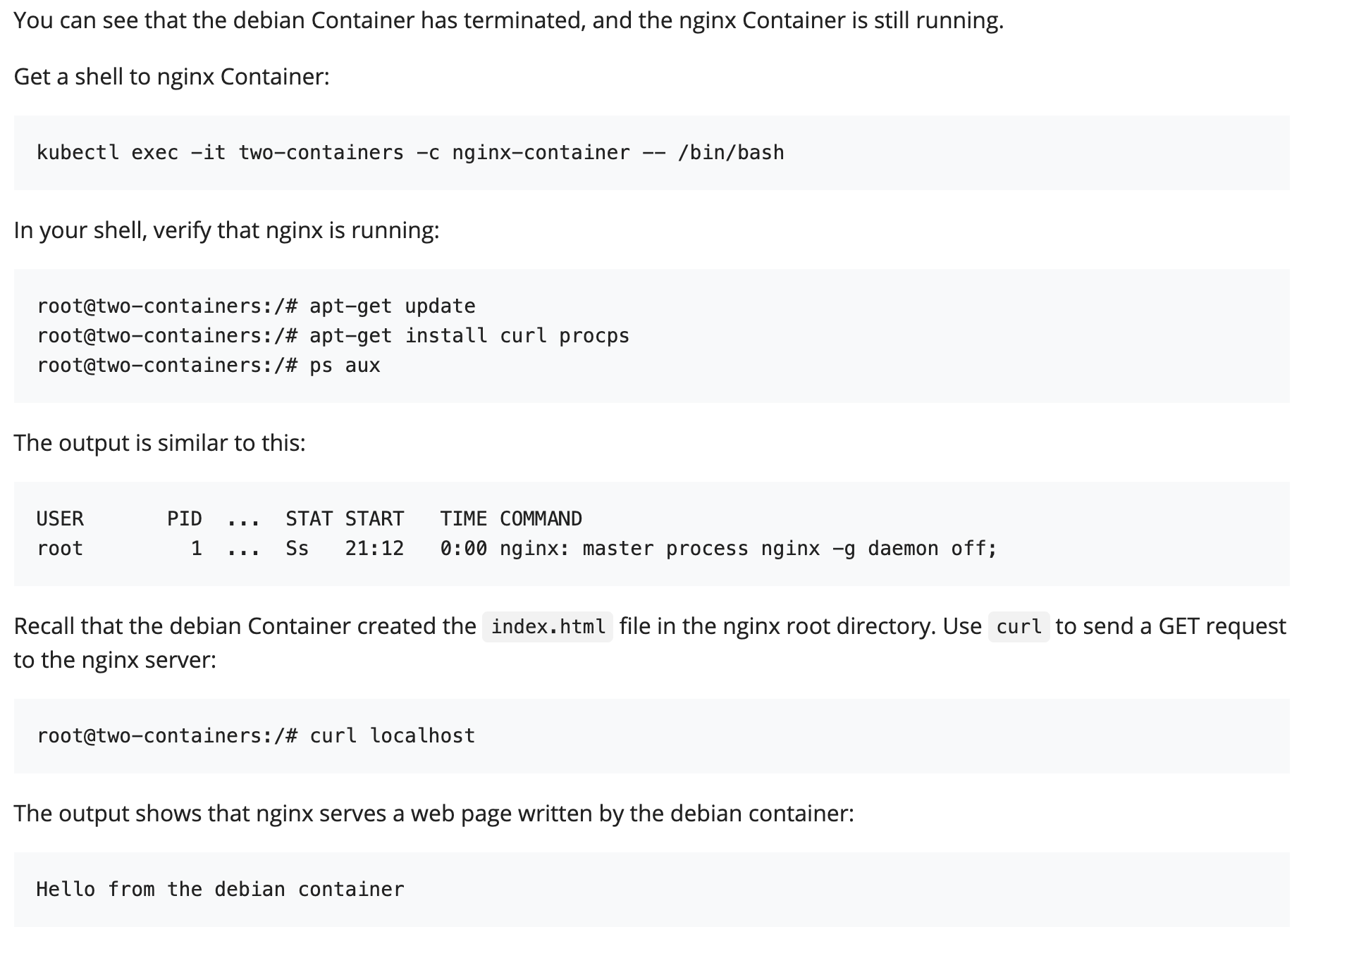
Make a pod
Multi container / one pod
Do this work-around if dns error occurs…
root@two-containers:/# cat > etc/resolv.conf <<EOF
> nameserver 8.8.8.8
> EOF
k exec -it two-containers -c nginx-container -- /bin/bash
cd /usr/share/nginx/html/
more index.html
볼륨의 종류 참조 : https://bcho.tistory.com/1259
Source : https://kubernetes.io/docs/tasks/access-application-cluster/communicate-containers-same-pod-shared-volume/

Slide 35
crictl

Slide 36
컨테이너 런타입 관리도구
ctr -n k8s.io container list
ctr -n k8s.io image list
vi /etc/crictl.yaml
crictl
crictl pods
crictl images
runtime-endpoint: unix:///run/containerd/containerd.sock
image-endpoint: unix:///run/containerd/containerd.sock

Slide 37
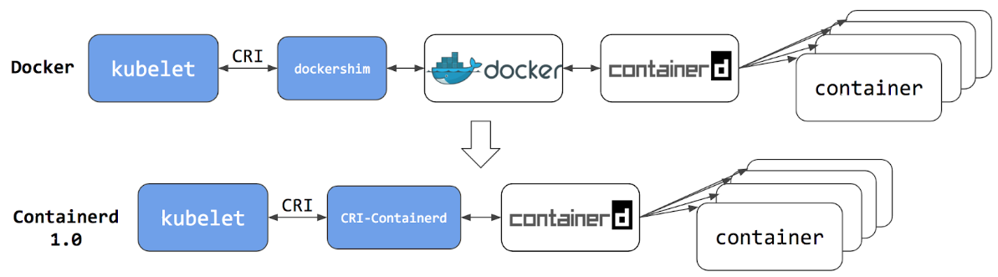
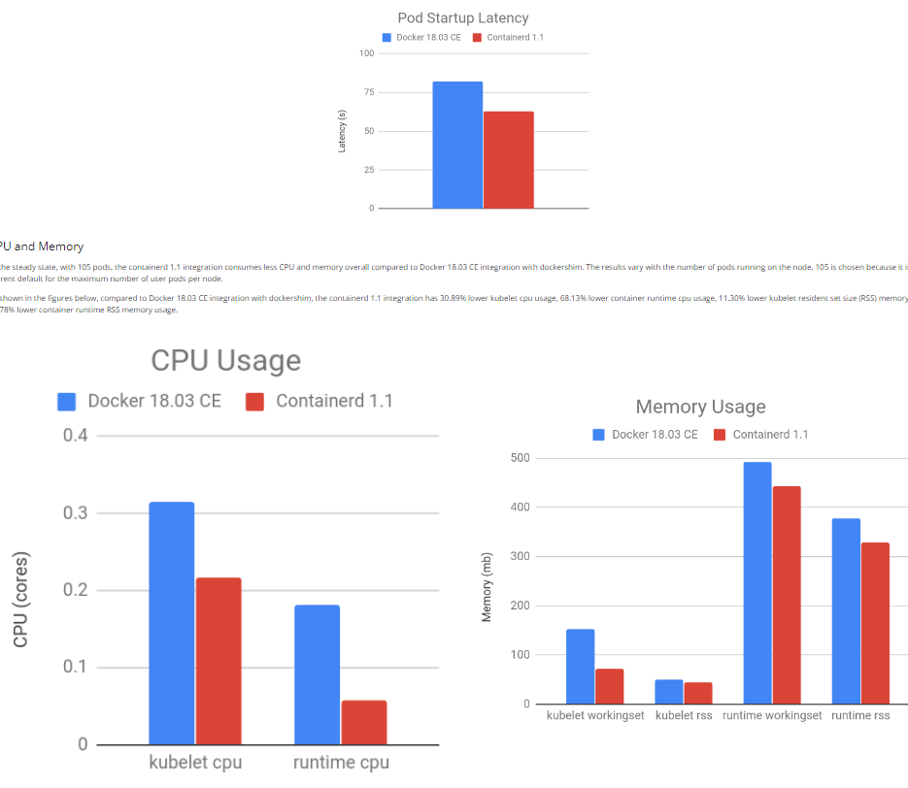
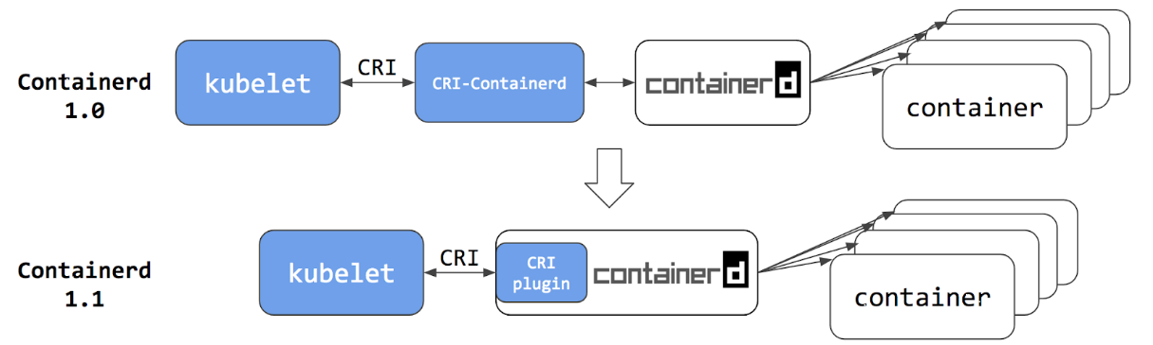
[참고] docker VS containerd
source : https://kubernetes.io/blog/2018/05/24/kubernetes-containerd-integration-goes-ga/#containerd-1-0-cri-containerd-end-of-life

Slide 38
Replicas

Slide 39
Replicas
k apply -f repltest.yml
k get rs
apiVersion: apps/v1
kind: ReplicaSet
metadata:
name: frontend
labels:
app: guestbook
tier: frontend
spec:
# 케이스에 따라 레플리카를 수정한다.
replicas: 3
selector:
matchLabels:
tier: frontend
template:
metadata:
labels:
tier: frontend
spec:
containers:
- name: php-redis
image: gcr.io/google_samples/gb-frontend:v3
Source : https://kubernetes.io/ko/docs/concepts/workloads/controllers/replicaset/

Slide 40
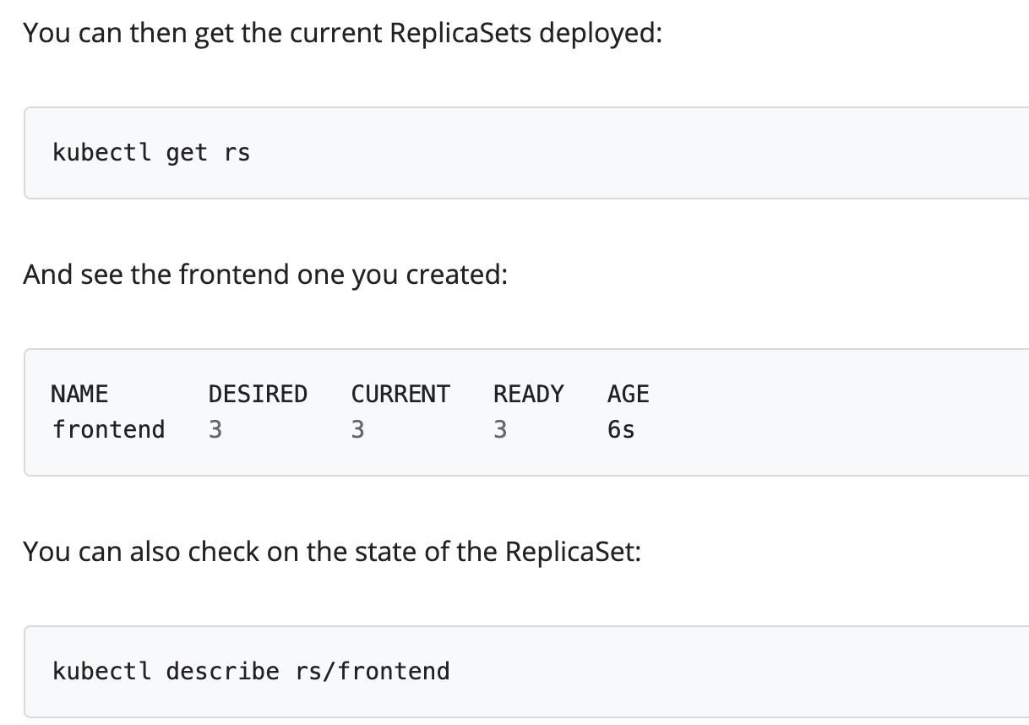
Replicas
root@kopo:~/project/ex03-replica# k get pods --show-labels
NAME READY STATUS RESTARTS AGE LABELS
frontend-jb9kl 1/1 Running 0 54s tier=frontend
frontend-ksbz8 1/1 Running 0 54s tier=frontend
frontend-vcpsm 1/1 Running 0 54s tier=frontend
kubernetes-bootcamp-6f6656d949-sdhqp 1/1 Running 0 10h app=kubernetes-bootcamp,pod-template-hash=6f6656d949
root@kopo:~/project/ex03-replica# k label pod/frontend-jb9kl tier-
pod/frontend-jb9kl labeled
root@kopo:~/project/ex03-replica# k get pods --show-labels
NAME READY STATUS RESTARTS AGE LABELS
frontend-4jbf6 1/1 Running 0 4s tier=frontend
frontend-jb9kl 1/1 Running 0 3m6s <none>
frontend-ksbz8 1/1 Running 0 3m6s tier=frontend
frontend-vcpsm 1/1 Running 0 3m6s tier=frontend
kubernetes-bootcamp-6f6656d949-sdhqp 1/1 Running 0 10h app=kubernetes-bootcamp,pod-template-hash=6f6656d949
root@kopo:~/project/ex03-replica# k label pod/frontend-jb9kl tier=frontend
pod/frontend-jb9kl labeled
root@kopo:~/project/ex03-replica# k get pods --show-labels
NAME READY STATUS RESTARTS AGE LABELS
frontend-jb9kl 1/1 Running 0 3m39s tier=frontend
frontend-ksbz8 1/1 Running 0 3m39s tier=frontend
frontend-vcpsm 1/1 Running 0 3m39s tier=frontend
kubernetes-bootcamp-6f6656d949-sdhqp 1/1 Running 0 10h app=kubernetes-bootcamp,pod-template-hash=6f6656d949
root@kopo:~/project/ex03-replica# k scale --replicas=6 -f repltest.yml
replicaset.apps/frontend scaled
root@kopo:~/project/ex03-replica# k get pods --show-labels
NAME READY STATUS RESTARTS AGE LABELS
frontend-8vwl6 1/1 Running 0 5s tier=frontend
frontend-jb9kl 1/1 Running 0 4m20s tier=frontend
frontend-ksbz8 1/1 Running 0 4m20s tier=frontend
frontend-lzflt 1/1 Running 0 5s tier=frontend
frontend-vbthb 1/1 Running 0 5s tier=frontend
frontend-vcpsm 1/1 Running 0 4m20s tier=frontend
kubernetes-bootcamp-6f6656d949-sdhqp 1/1 Running 0 10h app=kubernetes-bootcamp,pod-template-hash=6f6656d949
Delete label of one pod
Set the label
Add replica number
Source : https://kubernetes.io/ko/docs/concepts/workloads/controllers/replicaset/
Notes:
k get po -o wide

Slide 41
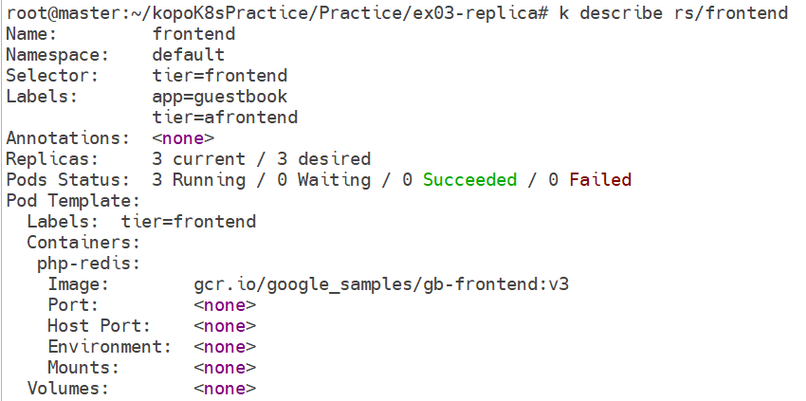
Replicas
k describe rs/<replicas name>
Notes:
test로 labels: tier의 value를 afrontend로 변경했었음

Slide 42
Deployment

Slide 43
Deployment
K apply -f deploytest.yml
kubectl get deployments kubectl rollout status deployment.v1.apps/nginx-deployment kubectl get rs kubectl get pods --show-labels
apiVersion: apps/v1
kind: Deployment
metadata:
name: nginx-deployment
labels:
app: nginx
spec:
replicas: 3
selector:
matchLabels:
app: nginx
template:
metadata:
labels:
app: nginx
spec:
containers:
- name: nginx
image: nginx:1.14.2
ports:
- containerPort: 80
Source : https://kubernetes.io/docs/concepts/workloads/controllers/deployment/

Slide 44
Deployment
Deployment update
kubectl edit deployment.v1.apps/nginx-deployment
kubectl rollout status deployment.v1.apps/nginx-deployment
kubectl describe deployments
In editor window, modify nginx version 1.14.2 -> 1.16.1
Source : https://kubernetes.io/docs/concepts/workloads/controllers/deployment/

Slide 45
Deployment
Deployment roll-back
kubectl rollout history deployment.v1.apps/nginx-deployment
버전 업 배포 k apply -f ~.yml
kubectl rollout history deployment.v1.apps/nginx-deployment --revision=2
kubectl rollout undo deployment.v1.apps/nginx-deployment --to-revision=2
kubectl describe deployment nginx-deployment
Or kubectl rollout undo deployment.v1.apps/nginx-deployment
Source : https://kubernetes.io/docs/concepts/workloads/controllers/deployment/

Slide 46
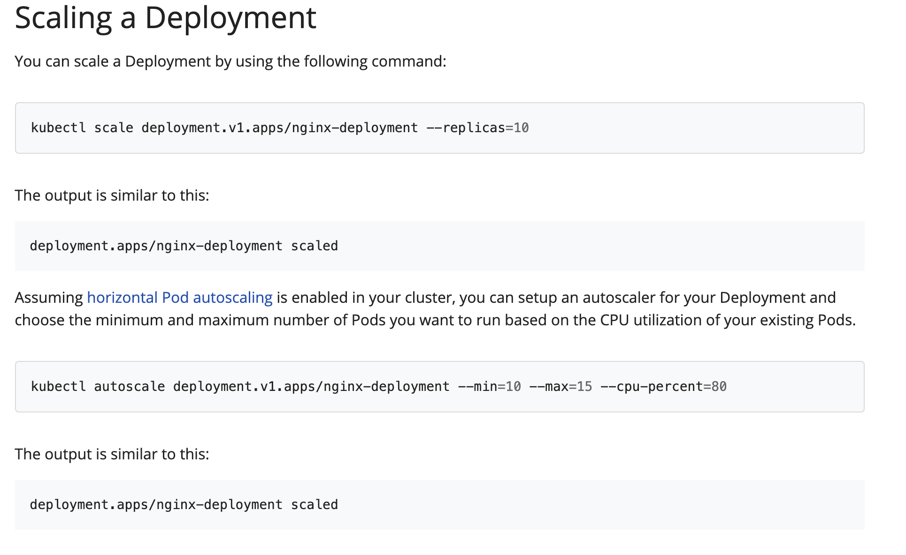
Deployment
Scaling
Source : https://kubernetes.io/docs/concepts/workloads/controllers/deployment/

Slide 47
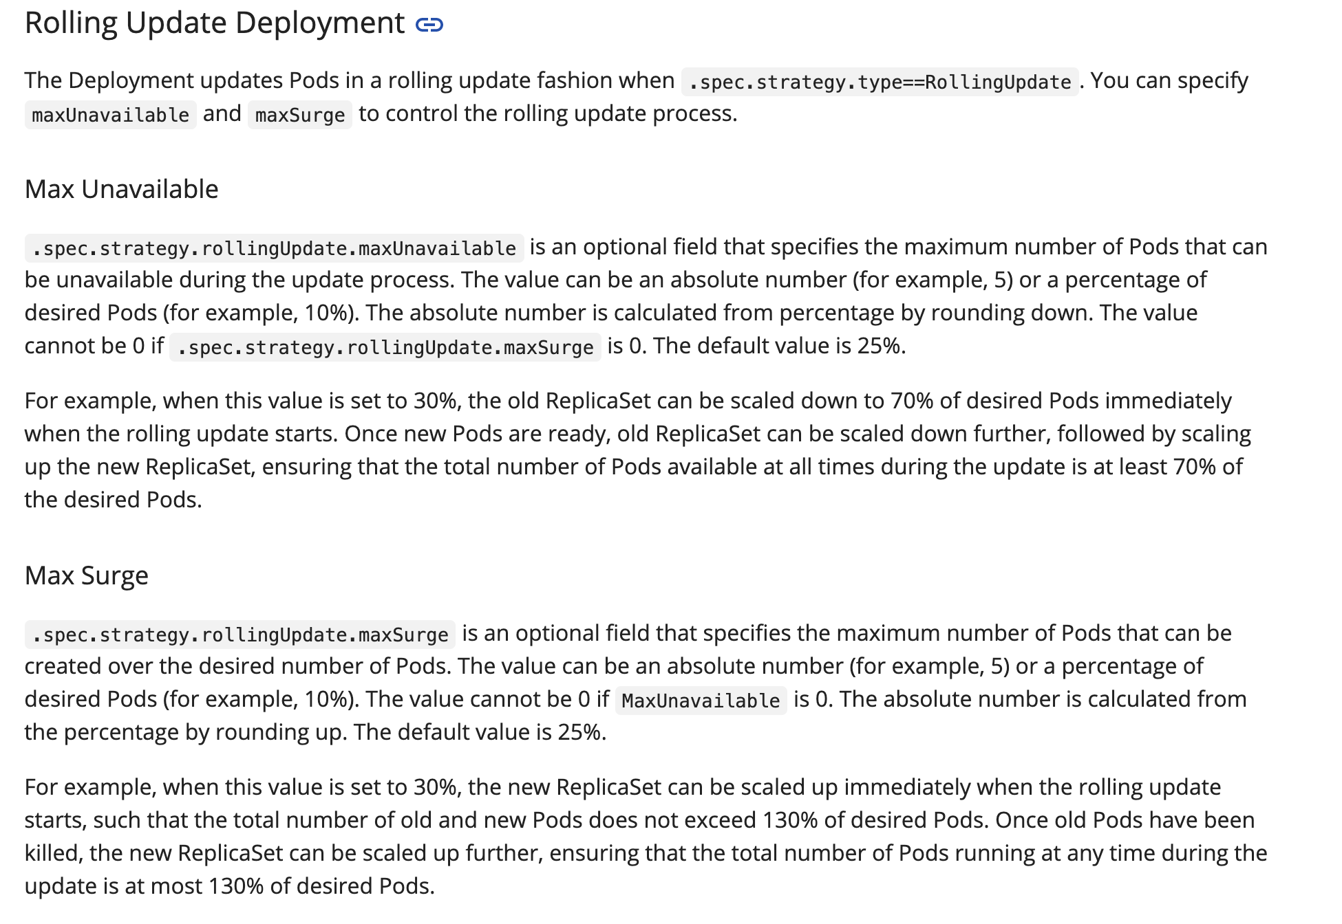
deployment
Rolling update
There are many strategies like
‘recreate’, ‘deadline seconds’ and so on.
Source : https://kubernetes.io/docs/concepts/workloads/controllers/deployment/#rolling-update-deployment

Slide 48
Service

Slide 49
Service
cluster ip (internal network)
apiVersion: apps/v1
kind: Deployment
metadata:
name: my-nginx
spec:
selector:
matchLabels:
run: my-nginx
replicas: 2
template:
metadata:
labels:
run: my-nginx
spec:
containers:
- name: my-nginx
image: nginx
ports:
- containerPort: 80
---
apiVersion: v1
kind: Service
metadata:
name: my-nginx
labels:
run: my-nginx
spec:
ports:
- port: 80
protocol: TCP
selector:
run: my-nginx
k apply -f clusterip.yml
Creating a Service
So we have pods running nginx in a flat, cluster wide, address space. In theory, you could talk to these pods directly,
but what happens when a node dies? The pods die with it, and the Deployment will create new ones, with different IPs. This is the problem a Service solves.
A Kubernetes Service is an abstraction which defines a logical set of Pods running somewhere in your cluster, that all provide the same functionality.
When created, each Service is assigned a unique IP address (also called clusterIP). This address is tied to the lifespan of the Service,
and will not change while the Service is alive. Pods can be configured to talk to the Service,
and know that communication to the Service will be automatically load-balanced out to some pod that is a member of the Service.
Source : https://kubernetes.io/ko/docs/concepts/services-networking/connect-applications-service/

Slide 50
Service
cluster ip (internal network)
k get all
kubectl get pods -l run=my-nginx -o wide
kubectl get pods -l run=my-nginx -o yaml | grep podIP
kubectl get svc my-nginx
kubectl describe svc my-nginx
kubectl get ep my-nginx
kubectl exec my-nginx-5dc4865748-rhfq8 -- printenv | grep SERVICE
root@kopo:~/project/ex04-deployment# k get all
NAME READY STATUS RESTARTS AGE
pod/kubernetes-bootcamp-6f6656d949-sdhqp 1/1 Running 1 23h
pod/my-nginx-5dc4865748-rhfq8 1/1 Running 0 36s
pod/my-nginx-5dc4865748-z7qkt 1/1 Running 0 36s
NAME TYPE CLUSTER-IP EXTERNAL-IP PORT(S) AGE
service/kubernetes ClusterIP 10.96.0.1 <none> 443/TCP 2d19h
service/my-nginx ClusterIP 10.110.148.126 <none> 80/TCP 36s
NAME READY UP-TO-DATE AVAILABLE AGE
deployment.apps/kubernetes-bootcamp 1/1 1 1 23h
deployment.apps/my-nginx 2/2 2 2 36s
NAME DESIRED CURRENT READY AGE
replicaset.apps/kubernetes-bootcamp-6f6656d949 1 1 1 23h
replicaset.apps/my-nginx-5dc4865748 2 2 2 36s
root@kopo:~/project/ex04-deployment# kubectl get pods -l run=my-nginx -o wide
NAME READY STATUS RESTARTS AGE IP NODE NOMINATED NODE READINESS GATES
my-nginx-5dc4865748-rhfq8 1/1 Running 0 60s 10.244.1.28 worker01 <none> <none>
my-nginx-5dc4865748-z7qkt 1/1 Running 0 60s 10.244.1.27 worker01 <none> <none>
root@kopo:~/project/ex04-deployment# kubectl get pods -l run=my-nginx -o yaml | grep podIP
f:podIP: {}
f:podIPs:
podIP: 10.244.1.28
podIPs:
f:podIP: {}
f:podIPs:
podIP: 10.244.1.27
podIPs:
root@kopo:~/project/ex04-deployment# kubectl get svc my-nginx
NAME TYPE CLUSTER-IP EXTERNAL-IP PORT(S) AGE
my-nginx ClusterIP 10.110.148.126 <none> 80/TCP 104s
root@kopo:~/project/ex04-deployment# kubectl describe svc my-nginx
Name: my-nginx
Namespace: default
Labels: run=my-nginx
Annotations: Selector: run=my-nginx
Type: ClusterIP
IP: 10.110.148.126
Port: <unset> 80/TCP
TargetPort: 80/TCP
Endpoints: 10.244.1.27:80,10.244.1.28:80
Session Affinity: None
Events: <none>
root@kopo:~/project/ex04-deployment# kubectl get ep my-nginx
NAME ENDPOINTS AGE
my-nginx 10.244.1.27:80,10.244.1.28:80 2m3s
root@kopo:~/project/ex04-deployment# kubectl exec my-nginx-5dc4865748-rhfq8 -- printenv | grep SERVICE
KUBERNETES_SERVICE_PORT_HTTPS=443
KUBERNETES_SERVICE_HOST=10.96.0.1
MY_NGINX_SERVICE_PORT=80
KUBERNETES_SERVICE_PORT=443
MY_NGINX_SERVICE_HOST=10.110.148.126
Source : https://kubernetes.io/ko/docs/concepts/services-networking/connect-applications-service/
Notes:
At worker node : root@worker01:~# curl http://10.100.93.92 —> from kubectl describe svc my-nginx

Slide 51
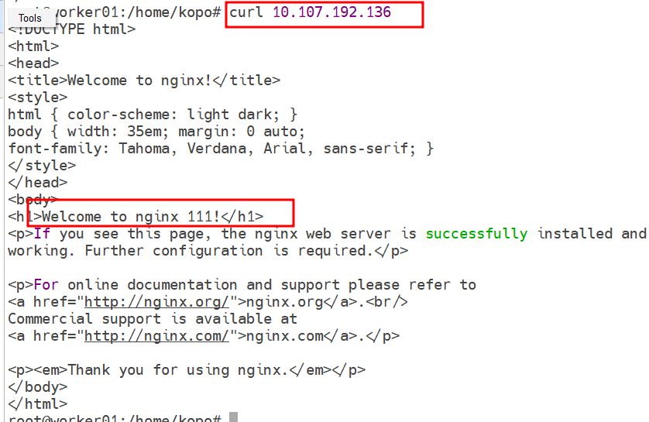
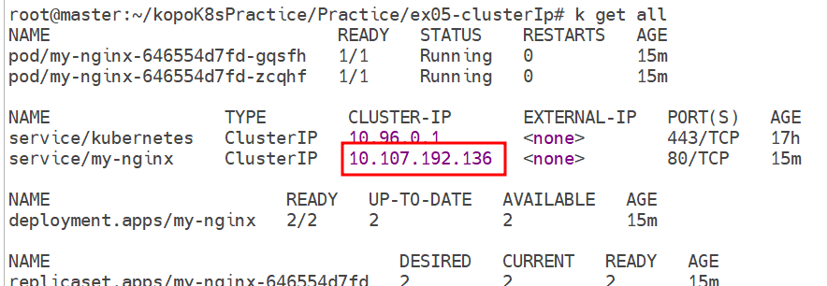
클러스터 IP로 접속 확인
Pod <-> Local File Copy
Pod의 Nginx 에서 서비스하는 index.html 파일을 로컬로 복사 k cp default/my-nginx-646554d7fd-gqsfh:usr/share/nginx/html/index.html ./index.html
index.html을 편집하여 Pod간 index.html 파일 내용을 다르게 구분해 둔다.
편집한 index.html 파일을 Pod로 복사 k cp ./index.html default/my-nginx-646554d7fd-gqsfh:usr/share/nginx/html/index.html
해당 Pod로 진입하여 변경된 파일 확인 k exec -it my-nginx-646554d7fd-gqsfh -- /bin/bash
접속 확인

Slide 52
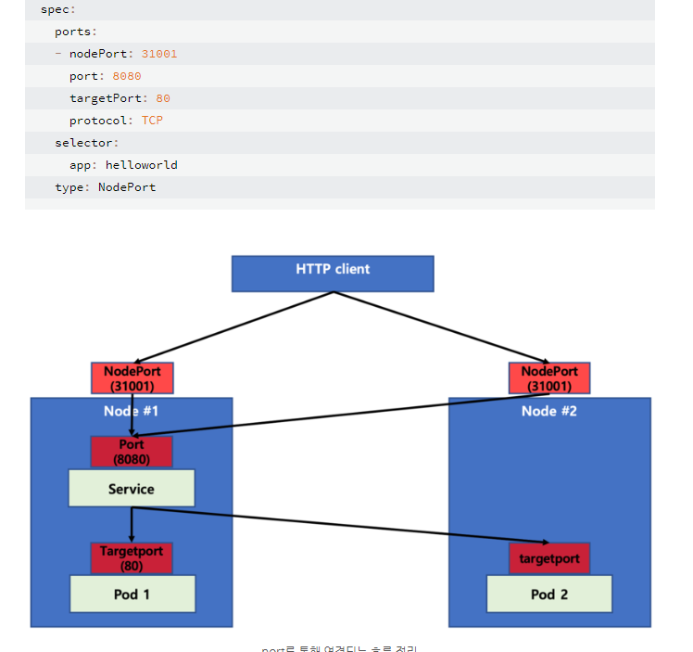
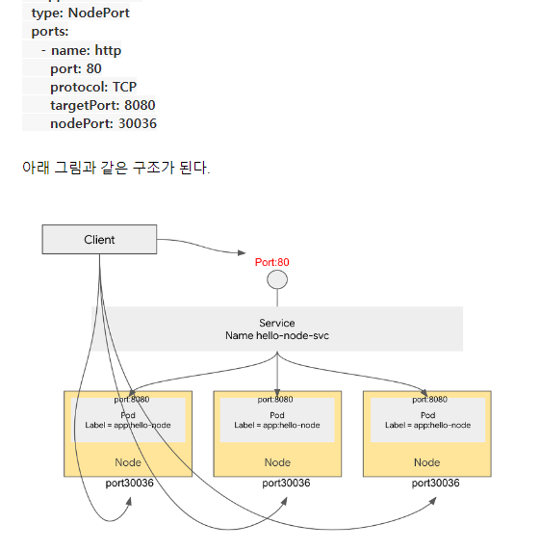
Service
Nodeport (expose network)
그림출처: https://m.blog.naver.com/PostView.naver?isHttpsRedirect=true&blogId=freepsw&logNo=221910012471
그림출처: https://bcho.tistory.com/tag/nodeport

Slide 53
Service
apiVersion: apps/v1
kind: Deployment
metadata:
name: my-nginx
spec:
selector:
matchLabels:
run: my-nginx
replicas: 2
template:
metadata:
labels:
run: my-nginx
spec:
containers:
- name: my-nginx
image: nginx
ports:
- containerPort: 80
---
apiVersion: v1
kind: Service
metadata:
name: my-nginx
labels:
run: my-nginx
spec:
type: NodePort
ports:
- protocol: TCP
nodePort: 30101
port: 80
targetPort: 80
selector:
run: my-nginx
Nodeport (expose network)
K apply -f nodeport.yml
At worker node: curl http://localhost:30101 -> OK curl http://10.107.58.105 -> OK, service endpoint(k get ep my-nginx) curl http://10.107.58.105:30101 -> X (nonsense) curl http://10.244.1.115:30101 -> X(nonsense; service unreachable to each pod’s endpoint as nodeport can only be access through Node not Pod)
Reference: https://bcho.tistory.com/tag/nodeport
Notes:
curl -k http://192.168.56.3:30101
839 k descrie svc my-nginx
840 k describe svc my-nginx
841 curl -k http://10.97.234.81:30101
842 curl -k http://localhost:30101
843 netstat -antp | grep 30101

Slide 54
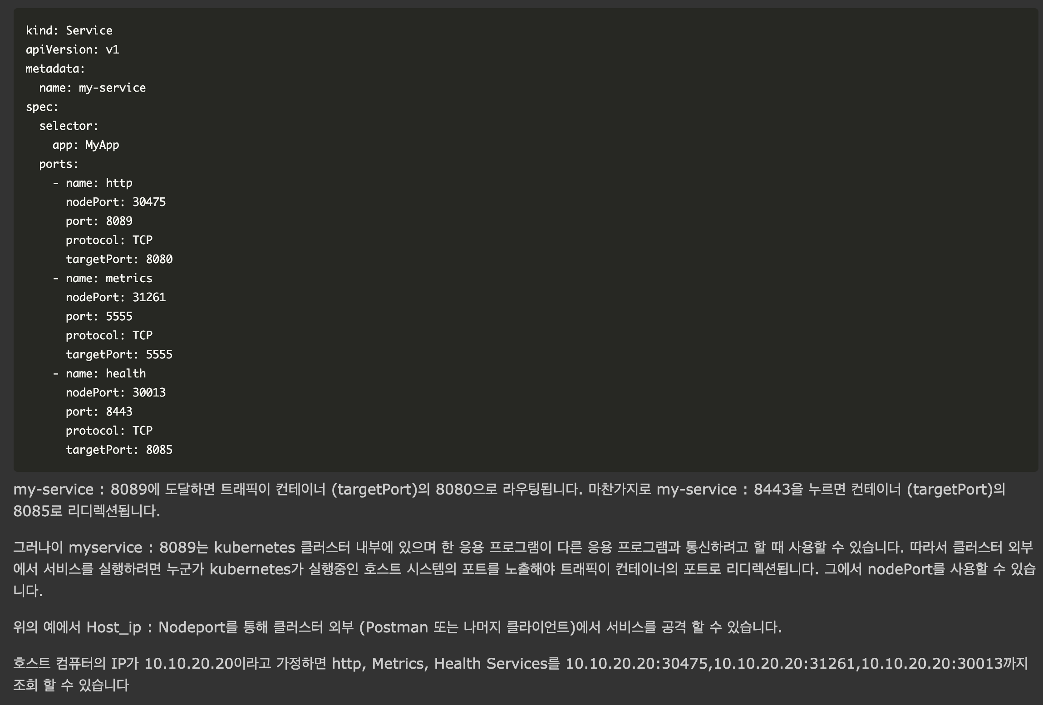

Service
Nodeport (expose network)
Nodeport, port, target port
Source : https://www.it-swarm-ko.tech/ko/kubernetes/kubernetes-%ec%84%9c%eb%b9%84%ec%8a%a4-%ec%a0%95%ec%9d%98%ec%97%90%ec%84%9c-targetport%ec%99%80-%ed%8f%ac%ed%8a%b8%ec%9d%98-%ec%b0%a8%ec%9d%b4%ec%a0%90/838752717/
Source : https://stackoverflow.com/questions/49981601/difference-between-targetport-and-port-in-kubernetes-service-definition

Slide 55
Ingress

Slide 56
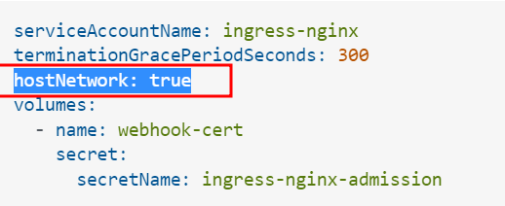
Ingress
https://kubernetes.github.io/ingress-nginx/deploy/#bare-metal
wget https://raw.githubusercontent.com/kubernetes/ingress-nginx/controller-v1.7.1/deploy/static/provider/baremetal/deploy.yaml
상기 다운로드 파일을 아래와 같이 편집
k apply -f deploy.yaml
← 추가!
Notes:
https://stackoverflow.com/questions/56915354/how-to-install-nginx-ingress-with-hostnetwork-on-bare-metal

Slide 57
ingress test
Test.yml
apiVersion: networking.k8s.io/v1
kind: Ingress
metadata:
name: test-ingress
annotations:
nginx.ingress.kubernetes.io/rewrite-target: /
spec:
rules:
- http:
paths:
- path: /testpath
pathType: Prefix
backend:
service:
name: test
port:
number: 80
If you got below error when executing “k apply -f test.yml”,
Error from server (InternalError): error when creating "STDIN": Internal error occurred: failed calling webhook
"validate.nginx.ingress.kubernetes.io": Post https://ingress-nginx-controller-admission.ingress-nginx.svc:443/extensions/v1beta1/ingresses?timeout=30s:
service "ingress-nginx-controller-admission" not found
Then you might have to delete ValidatingWebhookConfiguration (workaround)
kubectl delete -A ValidatingWebhookConfiguration ingress-nginx-admission
root@kopo:~/project/ex08-ingress# k get ingress
NAME CLASS HOSTS ADDRESS PORTS AGE
my-nginx <none> my-nginx.192.168.56.4.sslip.io 192.168.56.4 80 12m
test-ingress <none> * 192.168.56.4 80 13m
whoami-v1 <none> v1.whoami.192.168.56.3.sslip.io 192.168.56.4 80 11m
root@kopo:~/project/ex08-ingress#

Slide 58
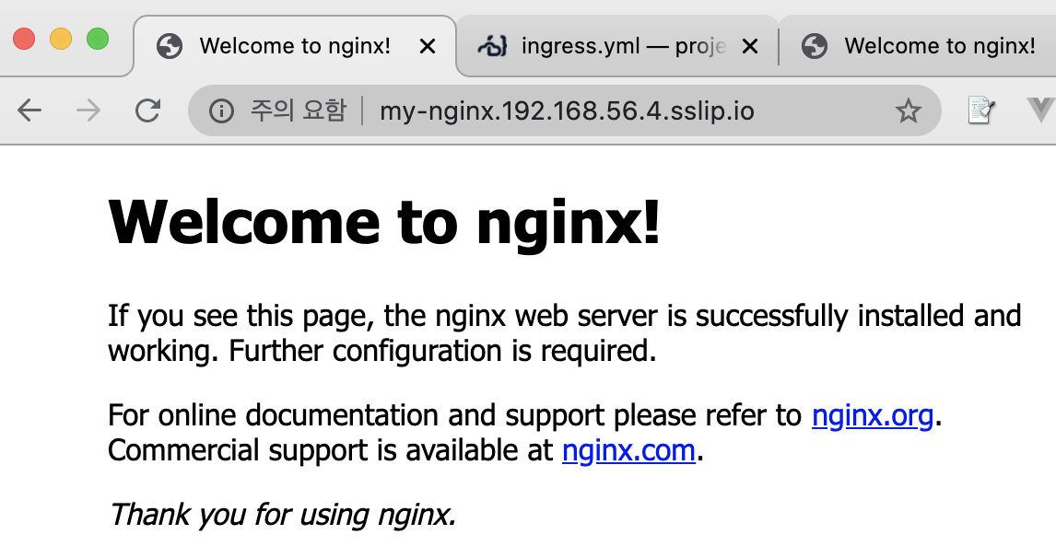
Ingress
Apply and test
K apply -f ingress.yml
root@kopo:~/project/ex08-ingress# k get all
NAME READY STATUS RESTARTS AGE
pod/my-nginx-694b8667c5-9dbdq 1/1 Running 0 9m31s
pod/my-nginx-694b8667c5-r274z 1/1 Running 0 9m31s
NAME TYPE CLUSTER-IP EXTERNAL-IP PORT(S) AGE
service/kubernetes ClusterIP 10.96.0.1 <none> 443/TCP 83d
service/my-nginx NodePort 10.108.46.127 <none> 80:30850/TCP 9m31s
NAME READY UP-TO-DATE AVAILABLE AGE
deployment.apps/my-nginx 2/2 2 2 9m31s
NAME DESIRED CURRENT READY AGE
replicaset.apps/my-nginx-694b8667c5 2 2 2 9m31s
root@kopo:~/project/ex08-ingress# k get ingress
NAME CLASS HOSTS ADDRESS PORTS AGE
my-nginx <none> my-nginx.192.168.56.4.sslip.io 192.168.56.4 80 9m38s
root@kopo:~/project/ex08-ingress# k get svc -n ingress-nginx
NAME TYPE CLUSTER-IP EXTERNAL-IP PORT(S) AGE
ingress-nginx-controller NodePort 10.110.64.145 <none> 80:31064/TCP,443:32333/TCP 80d
ingress-nginx-controller-admission ClusterIP 10.102.247.88 <none> 443/TCP 80d
root@kopo:~/project/ex08-ingress#
kind: Ingress
metadata:
name: my-nginx
annotations:
ingress.kubernetes.io/rewrite-target: "/"
ingress.kubernetes.io/ssl-redirect: "false"
kubernetes.io/ingress.class: "nginx"
spec:
rules:
- host: my-nginx.192.168.56.61.sslip.io
http:
paths:
- path: /
pathType: Prefix
backend:
service:
name: my-nginx
port:
number: 80
※ worker 노드에서 80 포트 방화벽 해제 필수 :
ufw allow 80/tcp

Slide 59
Tip & Trouble Shooting

Slide 60
Log search
kubectl logs [pod name] -n kube-system ex> kubectl logs coredns-383838-fh38fh8 -n kube-system
kubectl describe nodes

Slide 61
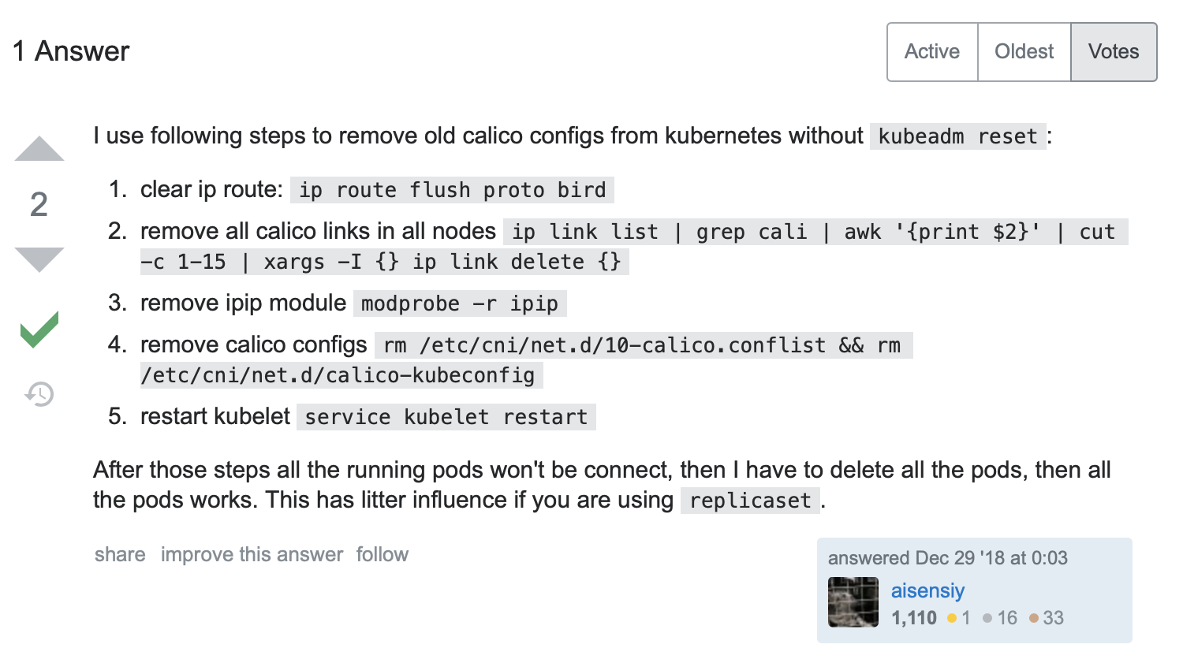

When you change network plugin…
Pods failed to start after switch cni plugin from flannel to calico and then flannel
Reference : https://stackoverflow.com/questions/53900779/pods-failed-to-start-after-switch-cni-plugin-from-flannel-to-calico-and-then-fla

Slide 62

When you lost token…
kubeadm token list
openssl x509 -pubkey -in /etc/kubernetes/pki/ca.crt | openssl rsa -pubin -outform der 2>/dev/null | openssl dgst -sha256 -hex | sed 's/^.* //‘
If you want to create new token; $ kubeadm token create
kubeadm join 192.168.56.3:6443 --token iyees9.hc9x59uz97a71rio \
--discovery-token-ca-cert-hash sha256:a5bb90c91a4863d1615c083f8eac0df8ca8ca1fa571fc73a8d866ccc60705ace

Slide 63
CoreDNS malfunctioning
https://www.it-swarm-ko.tech/ko/docker/kubernetes-클러스터에서-coredns가-실행되지-않습니다/806878349/
https://waspro.tistory.com/564

Slide 64
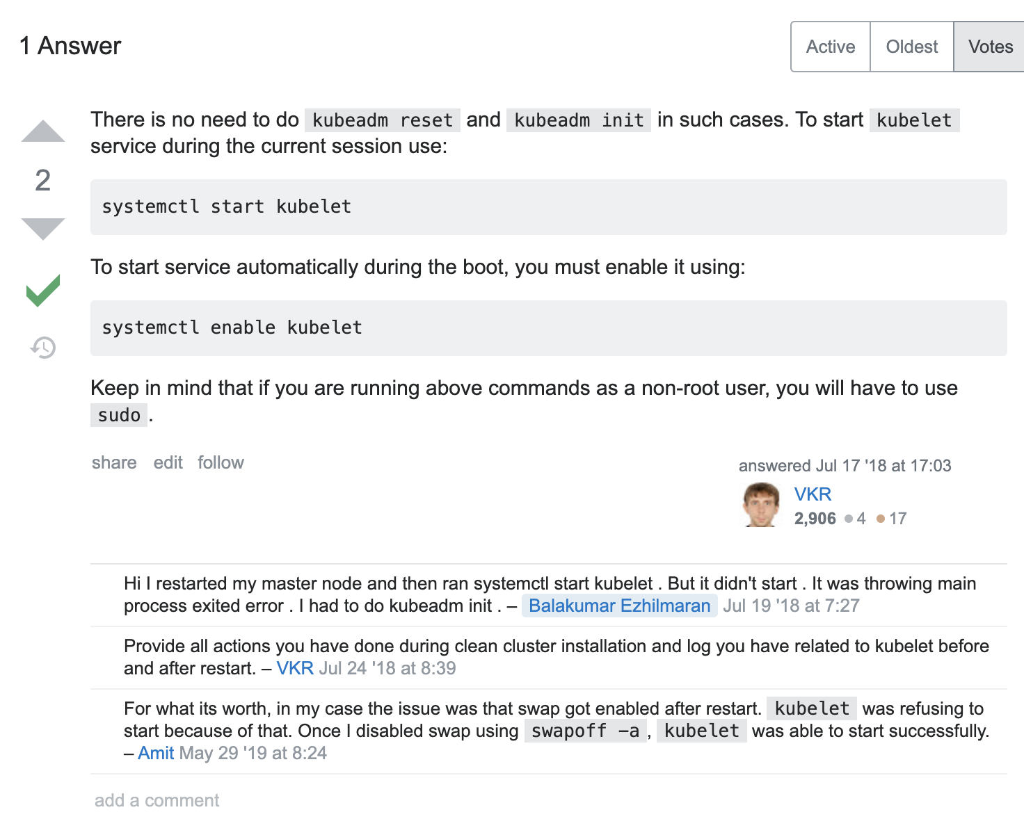
What should I do to bring my cluster up automatically after a host machine restart ?
Reference : https://stackoverflow.com/questions/51375940/kubernetes-master-node-is-down-after-restarting-host-machine

Slide 65
Cannot connect to the Docker daemon
Error Message : Cannot connect to the Docker daemon at unix:///var/run/docker.sock. Is the docker daemon running?
$sudo systemctl status docker
$sudo systemctl start docker
$sudo systemctl enable docker
Probably docker stopped

Slide 66
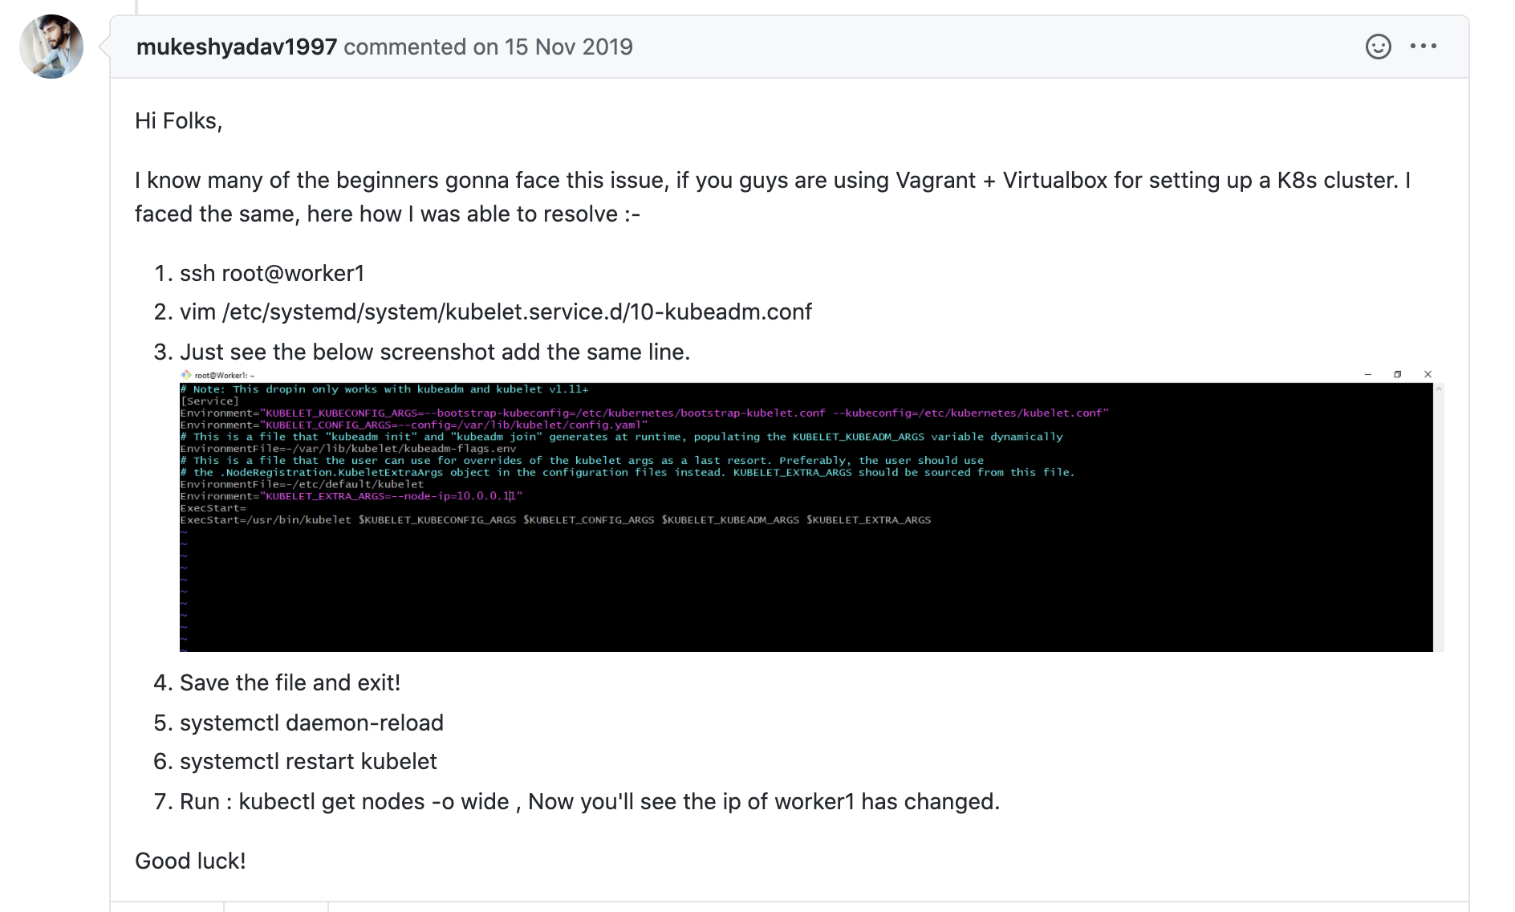
Pod connection error
root@kopo:~/project/ex02# k exec -it two-containers -c nginx-container -- /bin/bash error: unable to upgrade connection: pod does not exist
Conf 파일에
Environment="KUBELET_EXTRA_ARGS=--node-ip=<worker IP address>”
추가하고 서비스 재시작
Source : https://github.com/kubernetes/kubernetes/issues/63702

Slide 67
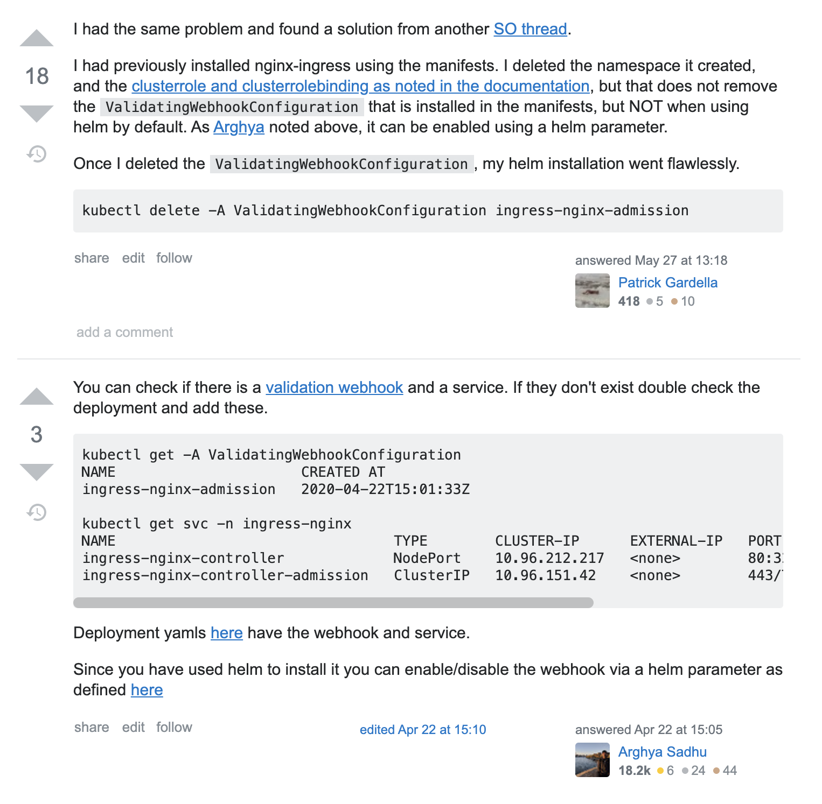
Nginx Ingress web hook error
Error from server (InternalError): error when creating "STDIN": Internal error occurred: failed calling webhook
"validate.nginx.ingress.kubernetes.io": Post https://ingress-nginx-controller-admission.ingress-nginx.svc:443/extensions/v1beta1/ingresses?timeout=30s:
service "ingress-nginx-controller-admission" not found
Then you might have to delete ValidatingWebhookConfiguration (workaround)
kubectl delete -A ValidatingWebhookConfiguration ingress-nginx-admission
Source : https://stackoverflow.com/questions/61365202/nginx-ingress-service-ingress-nginx-controller-admission-not-found

Slide 68
Ingress-nginx controller check if it is service properly
root@kopo:~/project/ex08-ingress# k exec -it po/ingress-nginx-controller-7fd7d8df56-qpvlr -n ingress-nginx -- /bin/bash
bash-5.0$ curl http://localhost/users
<!DOCTYPE html>
<html>
<head>
<style type="text/css">
body { text-align:center;font-family:helvetica,arial;font-size:22px;
color:#888;margin:20px}
#c {margin:0 auto;width:500px;text-align:left}
</style>
</head>
<body>
<h2>Sinatra doesn&rsquo;t know this ditty.</h2>
<img src='http://localhost/__sinatra__/404.png'>
<div id="c">
Try this:
<pre>get &#x27;&#x2F;users&#x27; do
&quot;Hello World&quot;
end
</pre>
</div>
</body>
</html>
root@kopo:~/project/ex08-ingress# kubectl get svc -n ingress-nginx
NAME TYPE CLUSTER-IP EXTERNAL-IP PORT(S) AGE
ingress-nginx-controller NodePort 10.110.64.145 <none> 80:31064/TCP,443:32333/TCP 110m
ingress-nginx-controller-admission ClusterIP 10.102.247.88 <none> 443/TCP 110m

Slide 69
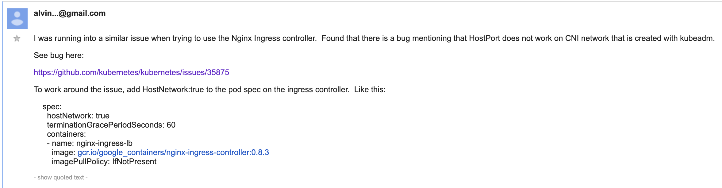
Nginx ingress controller - connection refused
apiVersion: apps/v1
kind: Deployment
metadata:
name: my-nginx
spec:
selector:
matchLabels:
run: my-nginx
replicas: 2
template:
metadata:
labels:
run: my-nginx
spec:
hostNetwork: true
containers:
- name: my-nginx
image: nginx
ports:
- containerPort: 80
Source : https://groups.google.com/forum/#!topic/kubernetes-users/arfGJnxlauU
Notes:
running on baremetal, ingress is working on service port, but on port 80 is not listening.
https://github.com/kubernetes/kubernetes/issues/31307

Slide 70
Kubeadm reset
Ref: https://likefree.tistory.com/13
# docker 초기화
$ docker rm -f `docker ps -aq`
$ docker volume rm `docker volume ls -q`
$ umount /var/lib/docker/volumes
$ rm -rf /var/lib/docker/
$ systemctl restart docker
# k8s 초기화
$ kubeadm reset
$ systemctl restart kublet
# iptables에 있는 데이터를 청소하기 위해
$ reboot

